Slide 1
Capstone Project Approval
Project Title : Intelligent Fashion Generation and
Retrieval System
Project ID : PW21KS09
Project Guide : Mr K.S. Srinivas
Project Team : Daksha Singhal PES1201700847
Kavya Khatter PES1201701136
Adithya Vardhan PES1201700788

Slide 2
Problem Statement
Competitive pressures are becoming higher and global demand continues to ask for new collections rapidly. Fast fashion is an economic phenomenon that has allowed everyone to dress following the latest trends.
Because of this overwhelming need of the society, we aim to generate new fashion styles from a collection of fashion Style images and also an intelligent fashion retrieval system which will be an ease component for user shopping.
Notes:
kavya
#revenue

Slide 3
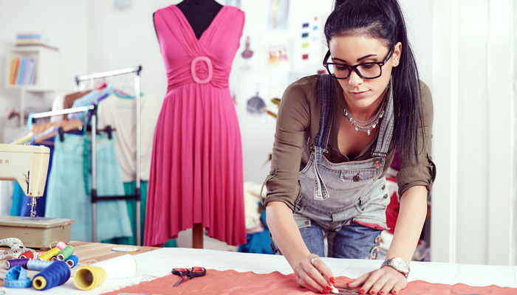
Use Cases
Conventional Fashion Designing
Salary: >46,000$
Time Spent : 2 - 4 weeks/design
Notes:
time comparison of generating clothes by our model and already present
no of designs generated are more
cost of a fashion designer is more

Slide 4
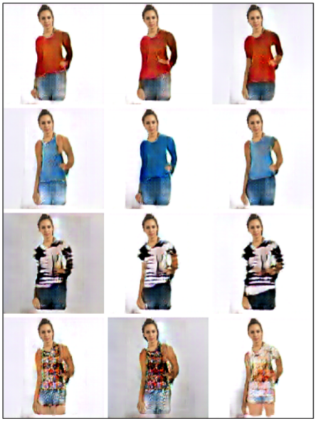
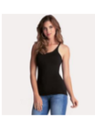

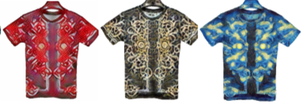
Use Cases
Different fashion design companies like Armani, Gucci ,Ralph Lauren are keen to personalize their apparel shopping experience in innovative ways using Deep Learning techniques by synthesizing fashion clothing based on their own collections.
(Input)
(Output)
Model
Summer Collection
Generated Images
Notes:
Designers companies usually take 2-4 weeks to design one dress
Our model takes in a collection of apparel and generates a new collection based on the features of the input collection
Give example

Slide 5
Literature Survey
Reference | DeepWear: a Case Study of Collaborative Design between Human and Artificial Intelligence, Natsumi Kato, Naoya Muramatsu , Hiroyuki Osone, Yoichi Ochiai , Daitetsu Sato University of Tsukuba
Abstract | DeepWear is a practical designing clothes system to generate images and designers make clothes by receiving instruction from those images
Dataset | Collected images of a specific brand announced between 2014 and 2017
Model | DC-GANs
Pros | Useful to learn unsupervised image representations
Cons | low Resolution
Notes:
Combined with noise injected directly into the network

Slide 6
Literature Survey
Reference | A Style-Based Generator Architecture for Generative Adversarial Networks, Tero Karras ,Samuli Laine, Timo Aila NVIDIA
Abstract | StyleGANS are automatically learned, unsupervised separation of high-level attributes and stochastic variation in the generated images and enabling intuitive, scale-specific control of the synthesis.
Dataset | Celeb Dataset
Model | Style GAN
Pros | Useful to learn unsupervised image representations as well as high quality images
Cons | Requires Powerful GPU

Slide 7
Literature Survey
Reference | Photo-Realistic Single Image Super-Resolution Using a Generative Adversarial Network, Christian Ledig, Lucas Theis, Ferenc Huszar, Jose Caballero, Andrew Cunningham, Alejandro Acosta, Andrew Aitken, Alykhan Tejani, Johannes Totz, Zehan Wang, Wenzhe Shi Twitter
Abstract | General Adversarial Network capable of inferring photo-realistic natural images of 4x upscale factor
Dataset | A database of human segmented natural images
Model | GANs
Pros | Useful for improving quality of low-resolution images
Cons | Good chance of mode-Collapse issue

Slide 8
Literature Survey
Reference | On Single Image Scale-Up Using Sparse-Representations, Roman Zeyde, Michael Elad, and Matan Protter
Abstract | Single image scale-up problem using sparse-representation modeling to recover an original image from its blurred and down-scaled noisy version
Dataset | Collected set of high resolution images
Model | Convoluted Neural Networks
Pros | Much faster than other similar algorithms due to the use of Dimensionality Reduction and PCA
Cons | If the generated image is blurred, the final image will be blurred to

Slide 9
Literature Survey
Reference | Generate High Resolution Images With Generative Autoencoder , A. Sagar, Vellore Institute of Technology
Abstract | We use a discriminator in place of the decoder while inputting values from the encoder as well as the generator and allow the discriminator to discern the real images.
Dataset | MNIST, LSUN and CelebA-HQ dataset
Model | Generative Adversarial Network with AutoEncoder
Pros | Solves the mode-collapse issue of image generation in GANs while also solving the blurring effect in image generation from VAEs
Cons | NA
Notes:
<Keep it short>
Next, we would like to explain our proposed implementation

Slide 10
Proposed Solution/Methodology
From the research work done so far, there are certain limitations which we can overcome using our model.
Preprocessing
Given input images of different fashion styles we aim to first classify the images into a predefined categories:
For this we have Built the model with 3 layers (1 layer to flatten the image to a 28 x 28 = 784 vector, 1 layer with 128 neurons and Relu activation function & 1 layer with 10 neurons and the Softmax function). We have 10 Neurons because we have 10 labels for the image data set.
Input type : Image
Output Type : Category Number(0-9)
T-Shirt (0) | Trouser (1) | Pullover (2) | Dress (3) | Coat (4)
Sandal (5) | Shirt (6) | Sneaker (7) | Bag (8) | Ankle Boot (9)
Notes:
Built the model with 3 layers (1 layer to flatten the image to a 28 x 28 = 784 vector, 1 layer with 128 neurons and relu activation function & 1 layer with 10 neurons and the Softmax function). We have 10 neurons because we have 10 labels for the image data set.
0=T-shirt / Top 1=Trouser 2=Pullover 3=Dress 4=Coat 5=Sandal 6=Shirt 7=Sneaker 8=Bag 9=Ankle Boot
##kavya

Slide 11
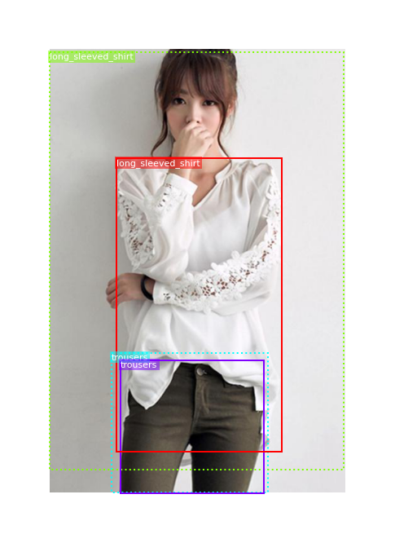
Proposed Solution/Methodology
●Bounding Box approach:
Cropping based on different apparels of the human pose image

Slide 12
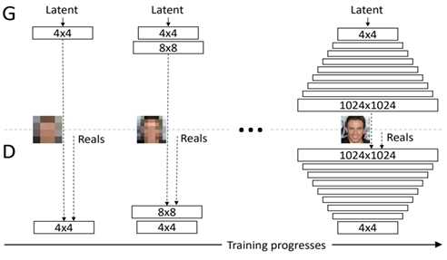
Proposed Solution/Methodology
Approach 1:
Using PGAN
In this design the generator and discriminator are kept symmetric in depth during training and adding layers step-wise, much like the greedy layer-wise pretraining technique in the early developing of deep neural networks, except weights in prior layers are not frozen. The key idea is to grow both the generator and discriminator progressively: starting from a low resolution, we add new layers that model increasingly fine details as training progresses.
Pros:
High Resolution images will be Generated.
Cons:
Powerful GPUs can be a requirement
Notes:
Vanilla gans have 3 problems:
1)feature entanglement:a GAN is not as capable of distinguishing these finer details as a human, thus leading the features to become “entangled” with each other to some extent within the GAN’s frame of perception. to avoid greater noise is added to assert to details
2) generalization
Perceptual path length — Calculate the difference between VGG16 embeddings of images when interpolating between two random inputs. A drastic change indicates that multiple features have changed together and thus might be entangled.
Linear separability — Classify all inputs into binary classes, such as male and female. The better the classification, the more separable the features.

Slide 13
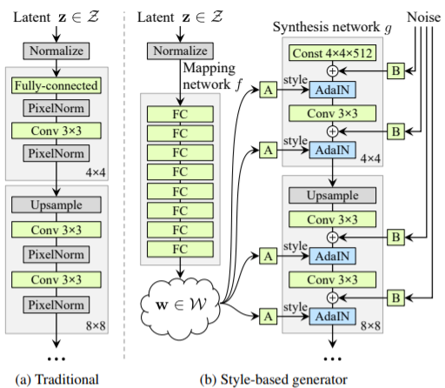
Proposed Solution/Methodology
Approach 2:
Style Gans
Using the intermediate latent space, the StyleGAN architecture lets the user make small changes to the input vector in such a way that the output image is not altered dramatically. A “mapping network” is included that maps an input vector to another intermediate latent vector, which is then fed to the generator network.

Slide 14
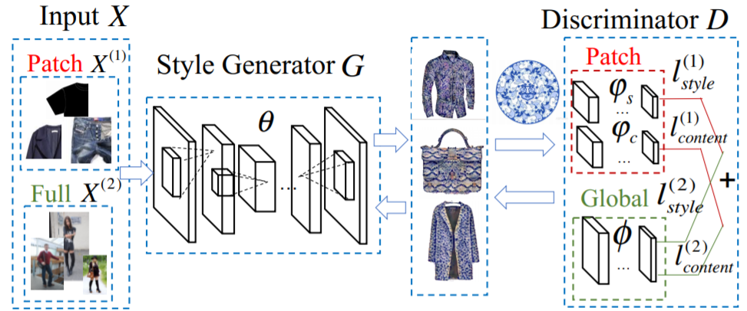
Proposed Solution/Methodology
Approach 3:
GAN with an alternating global-patch backpropagation
an image transformation network G and a discriminator network D calculates both global and patch based content and style reconstruction losses.
Alternating global-patch backpropagation strategy is proposed to optimize the generator to preserve both global and local structures.
Although the resolution of the generated images would be lower than the original.
To deal with this problem we introduce a model that would reconstruct the low resolution image into a high resolution image.
Notes:
The global and patch based style and content losses calculated by the discriminator alternatively back-propagate the generator network and optimize it.The global optimization stage preserves the clothing form and design and the local optimization stage preserves the detailed style pattern.

Slide 15
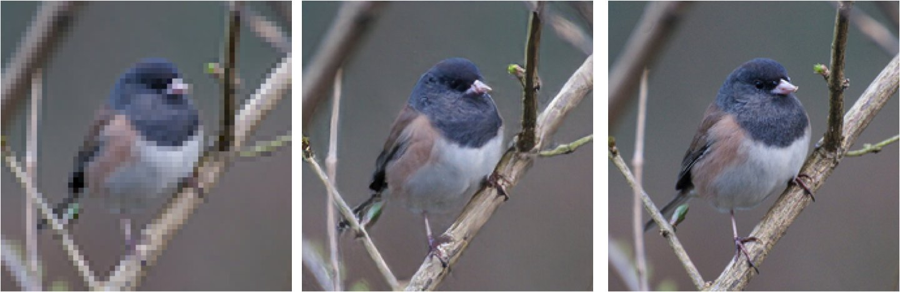
Proposed Solution/Methodology
Extended Approach 3:
Generative Variational Encoders
A Variational AutoEncoder with a Discriminator instead of a Decoder.
We replace the decoder of VAE with a discriminator while using the encoder as it is.The encoder uses data from a normal distribution while the generator from a gaussian distribution. The combination from both is given to a discriminator which tells whether the generated images are correct or not.
Using GANs as a stand-alone model was susceptible to mode-collapse issue while VAEs couldn’t solve the blurring issue by itself. So by combining the models together, we not only solve both of these issues together but also allow for improved results.
4x
Notes:
T

Slide 16
Proposed Solution/Methodology
Approach 4:
Using DCGAN
A DCGAN is a direct extension of the vanilla GAN, except that it explicitly uses convolutional and convolutional-transpose layers in the discriminator and generator, respectively.
Cons:
Conv-transpose layers allow the latent vector to be transformed into a volume with the same shape as the input, though the resolution of the new generated image can be less or equal to the input image.
Pros:
DCGAN tend to preserve the texture and color attributes from the input image.
Notes:
kavya

Slide 17
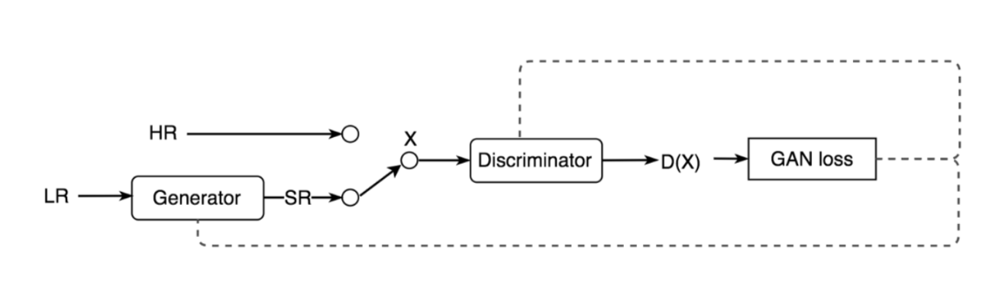
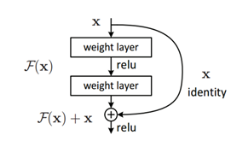
Proposed Solution/Methodology
Modified approach 4:
We propose a new improved technique based on the GAN architecture and Residual Blocks. A Residual Block is simply when the activation of a layer is fast-forwarded to a deeper layer in the neural network.
Acc to our design ,instead of residual blocks, inverted residual blocks can be employed for parameter efficiency and fast operation.
GAN Architecture
Residual block
Notes:
true loss and loss functions
kavya

Slide 18
Software/Hardware
Software Dependencies:
Python 3
TensorFlow
Keras
Cv2
Hardware Dependencies:
8Gb Ram and onwards
Nvidia-P100 GPU
Hard Drive (Min 100 Gb)
Notes:
Aaditya

Slide 19
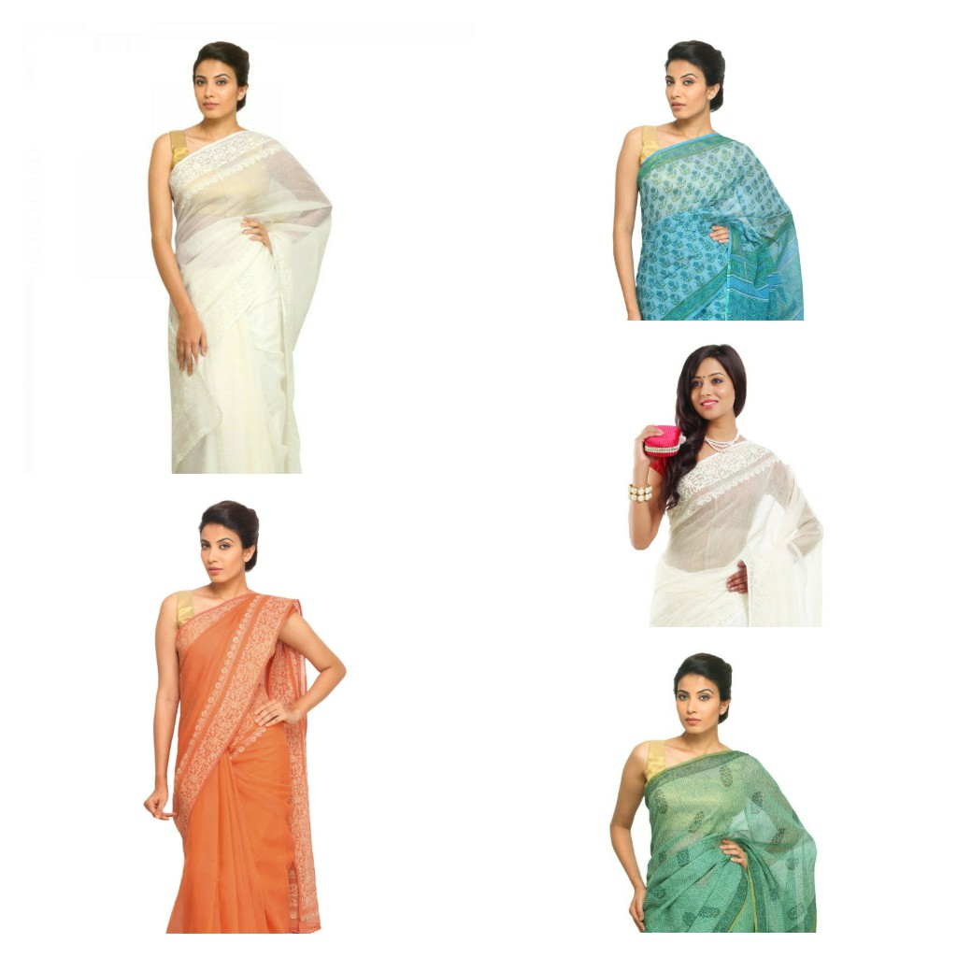
Data Requirements
At each stage, datasets differs with regard to the model requirements.
In the preprocessing stage,for the bounding box approach
a set of 500+ images containing different
e-commerce products like shoes, tshirts, dress etc
with their respective coordinates of the bounding
box is used.
For classifying the images into a clothing
categories MNIST fashion dataset is used.
For training the model for generating images
Kaggle Product Images Dataset will incorporated.
Notes:
add snapshot of dataset

Slide 20
Software Development Methodologies
We will be using the Agile Methodology for our project
Split into 5 sprints
Each sprint will last a duration of 2 weeks
Each sprint will end with a deliverable
Gantt Chart is provided here

Slide 21
Expected Deliverables
Capstone-I deliverables
We aim to build a GAN model for the Generation of new relevant fashion styles in high resolution.
Capstone-II deliverables
Integrating Generation of Fashion styles with Dialogue based Retrieval System.
Releasing our Product as a service.
Product Testing by real world customers.

Slide 22
Thank You

Slide 23
Literature Survey
Reference | Fashion Style Generator ,Shuhui Jiang and Yun Fu1 Department of Electrical and Computer Engineering, Northeastern University, Boston, MA 02115, USA
Abstract | Given a basic clothing image and a fashion style image (e.g., leopard print),generate a clothing image with the certain style in real time with a neural fashion style generator
Dataset | Fashion 144k dataset
Model | GAN with an alternating global-patch backpropagation strategy to optimize the generator to preserve both global and local structures.
Pros | Combines the benefits of both global and patch based methods and avoid their disadvantages.
Cons | The resolution of the generated clothings are still lower than the real clothing.
Notes:
takes 2 input picture and output generated image

